Slide 1
The Kronecker Product

Slide 2

The Kronecker product is defined for two matrices of arbitrary size.

Slide 3
If A is (2 X 2) and B is (3 X 2) then

Slide 4
Example 1

Slide 5
Solution

Slide 6
Solution
0 0 5 10
D = 0 0 15 20
6 12 7 14
18 24 21 28

Slide 7
Example 2

Slide 8
Solution

Slide 9
Solution

Slide 10
Properties of the Kronecker Product
1. It does not matter where we place multiplication with a scalar

Slide 11

2. Taking the transpose before carrying out the Kronecker product yields the same result as doing so afterwards.

Slide 12

3. Taking the complex conjugate before carrying out the Kronecker product yields the same result as doing so afterwards

Slide 13

4. The Kronecker product is associative

Slide 14

5. The Kronecker product is right–distributive

Slide 15

6. The Kronecker product is left–distributive

Slide 16

7. The product of two Kronecker products
yields another Kronecker product.

Slide 17
Unitaty Matrix
If T is a unitary matrix then
T*’ = T⁻¹
Multiplying both sides by T, then
T . T*’ = T . T⁻¹
T . T*’ = I
Here * indicate complex conjugate of T, I is Unity matrix.
Hence the condition to check whether a matrix is unitary or not; we need to check the relationship T . T*’ = I

Slide 18
Orthogonal Matrix
If T is unitary and have only real elements, then it is orthogonal matrix and it follows that
T’ = T⁻¹
Multiplying both sides by T, then
T . T’ = T . T⁻¹
T . T’ = I
Hence, an orthogonal matrix is a square matrix whose transpose is its inverse.
For orthogonal matrix the dot product of its any two row vectors or any two column vectors is zero.

Slide 19
If T is unitary, T . T*’ = I and T is orthogonal if T . T’ = I
If T contents only real numbers then if T . T’ = I.
Hence for real data if T . T’ = I; then T is unitary as well as orthogonal.

Slide 20
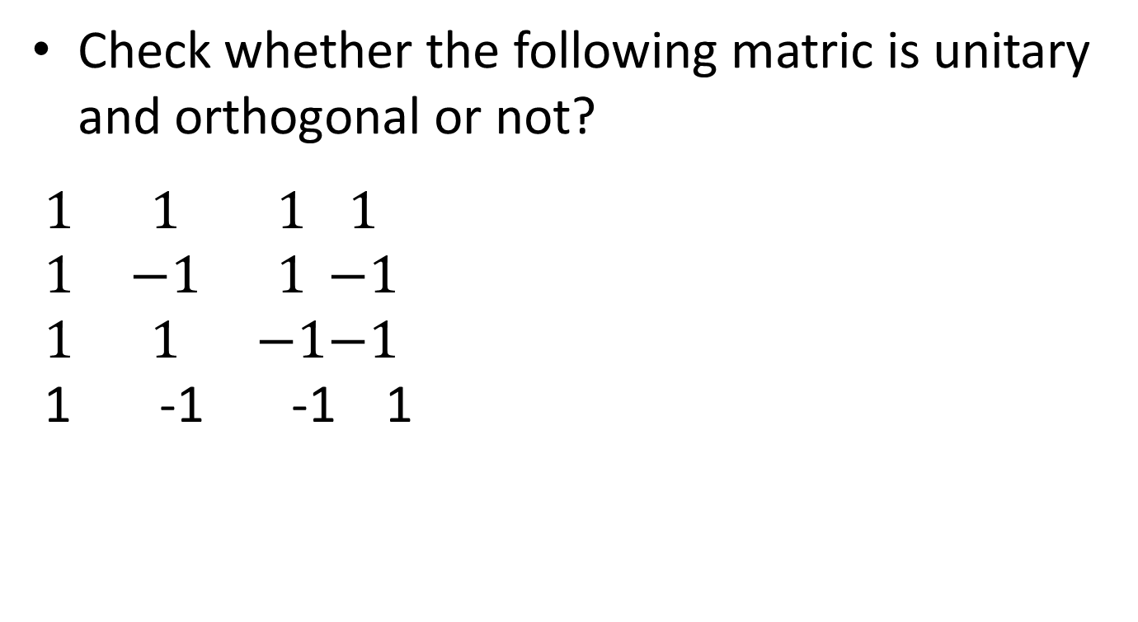
Check whether the following matric is unitary and orthogonal or not?
$\begin{matrix}1 & 1 & 1 \\ 1 & −1 & 1 \\ 1 & 1 & −1\end{matrix}\begin{matrix}1 \\ −1 \\ −1\end{matrix}$
1 -1 -1 1

Slide 21
What is Image Transform

Slide 22
Classification of Image Transforms

Slide 23
Image transforms - Introduction
Applying Transform we get another image of same size.
After applying Inverse Transform we get the original image back.
Then what is the use of Image transformation?
What does the Image Transform do?
It represents the given image as a series summation of a set of Unitary Matrices.

Slide 24
What is Image Transform?

Slide 25
What is Image Transform?

Slide 26
Applications
Preprocessing
-Filtering
-Enhancement, etc
Data Compression
Feature Extraction
-Edge Detection
-Corner detection, etc

Slide 27
General Formula
F = T*f*T’
Where,
T = Transform Matrix
T’ = Transpose of T
f = Input Image
F = Output Image

Slide 28
Inverse Formula
If I is inverse of T then, the inverse formula is -
f = I*F*I’

Slide 29
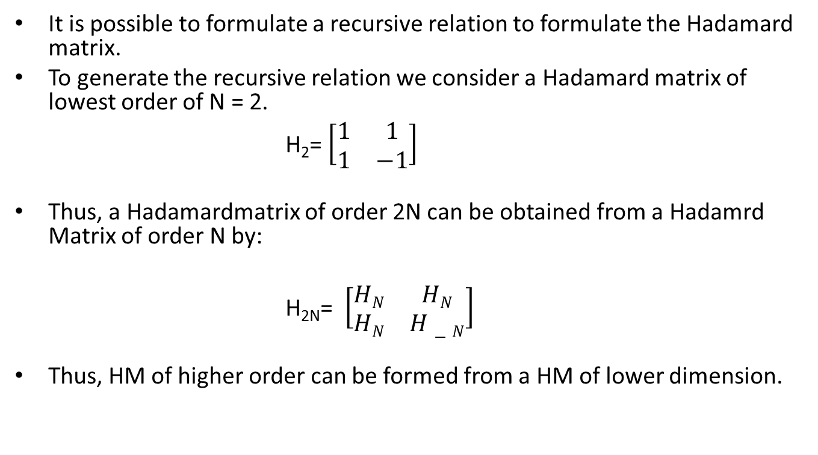
Hadamard Transform
It is possible to formulate a recursive relation to formulate the Hadamard matrix.
To generate the recursive relation we consider a Hadamard matrix of lowest order of N = 2.
H₂= $\left[\begin{matrix}1 & 1 \\ 1 & −1\end{matrix}\right]$
Thus, a Hadamardmatrix of order 2N can be obtained from a Hadamrd Matrix of order N by:
H_{2N}= $\left[\begin{matrix}HN & HN \\ HN & H−N\end{matrix}\right]$
Thus, HM of higher order can be formed from a HM of lower dimension.

Slide 30

Hadamard Transform
$H_{4 }$ = $\left[\begin{matrix}H2 & H2 \\ H2 & H−2\end{matrix}\right]$
$H_{4}$ = $\left[\begin{matrix}1 & 1 & 1 & 1 \\ 1 & −1 & 1 & −1 \\ 1 & 1 & −1 & −1 \\ 1 & −1 & −1 & 1\end{matrix}\right]$

Slide 31
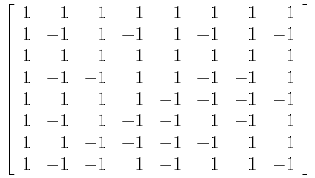

Hadamard Transform
$H_{8 }$ = $\left[\begin{matrix}H4 & H4 \\ H4 & H−4\end{matrix}\right]$
H₈ =

Slide 32
Hadamard Transform
Sign Changes
H₈ =

Slide 33
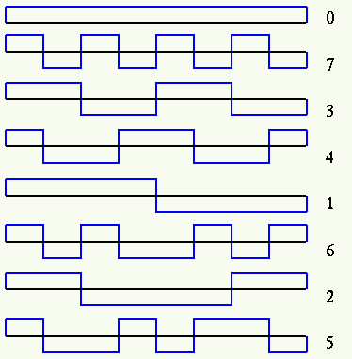
Sequency
Sequency

Slide 34
Properties of Hadamard Transform
(1)HadamardTransform H is real, symmetric & orthogonal. H = H*= HT= H-1
(2)It is fast transform. The 1D transformation can be implemented in Nlog₂N additions and subtraction. Since Hadamard Ttansform contain only +/-values, no multiplications are required in the calculations.
(3)It has very good energy compression for highly correlated images.
(4)It is useful in hardware implementation for DFT algorithm, used in image, data compression, filtering and designing of codes.

Slide 35
Problem 1
Compute the Hadamard transform of the data sequence {1 2 0 3}’

Slide 36
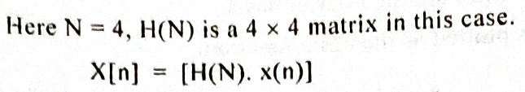
Solution 1

Slide 37
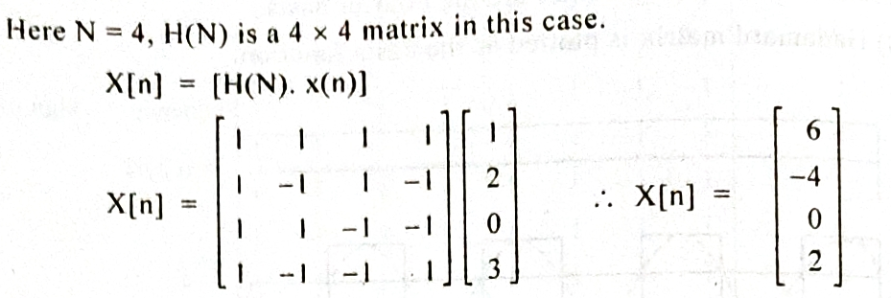
Solution 1

Slide 38
Problem - 2
Compute the inverse Hadamrd of the sequence {6 -4 0 2}’

Slide 39
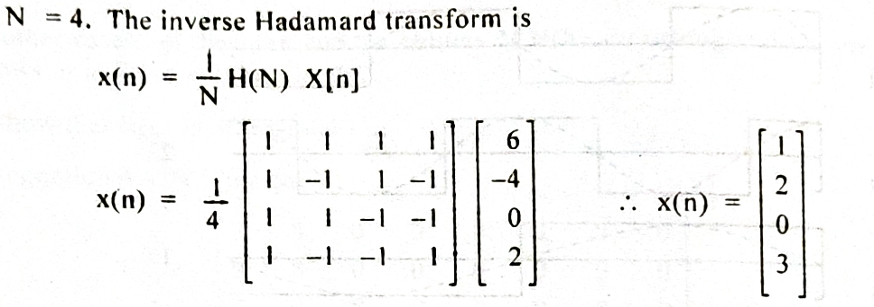
Solution - 2

Slide 40
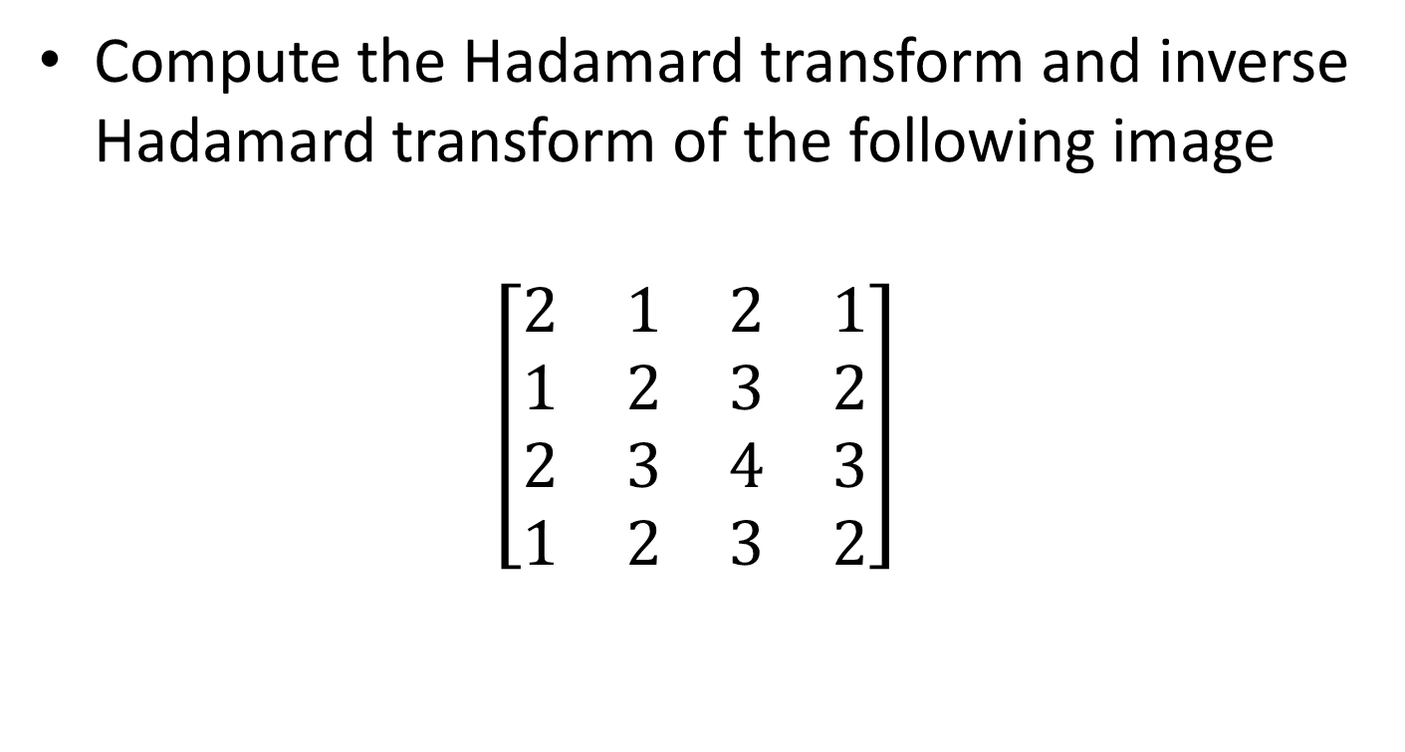
Problem-3
Compute the Hadamard transform and inverse Hadamard transform of the following image
$$\left[\begin{matrix}2 & 1 & 2 & 1 \\ 1 & 2 & 3 & 2 \\ 2 & 3 & 4 & 3 \\ 1 & 2 & 3 & 2\end{matrix}\right]$$

Slide 41

Solution 3

Slide 42
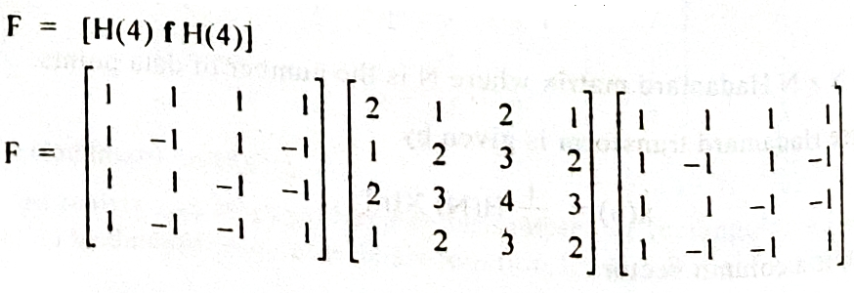

Slide 43
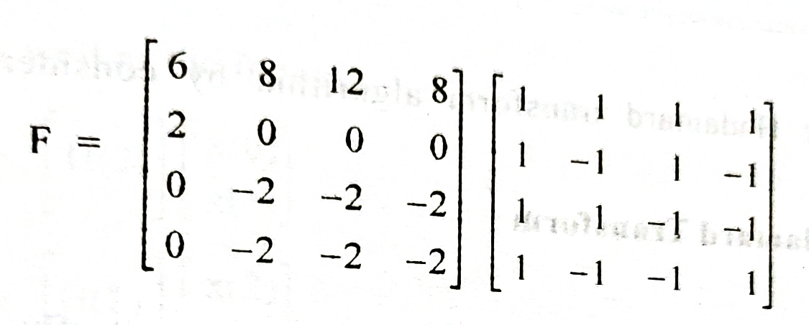

Slide 44
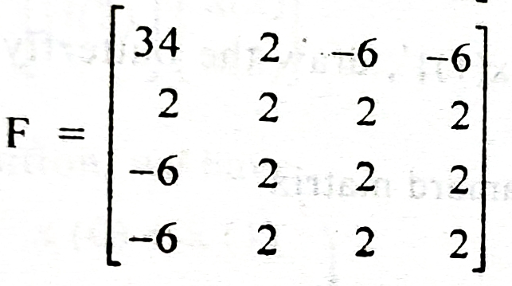

Slide 45
F(comp)
F(col)
F(row)

Slide 46
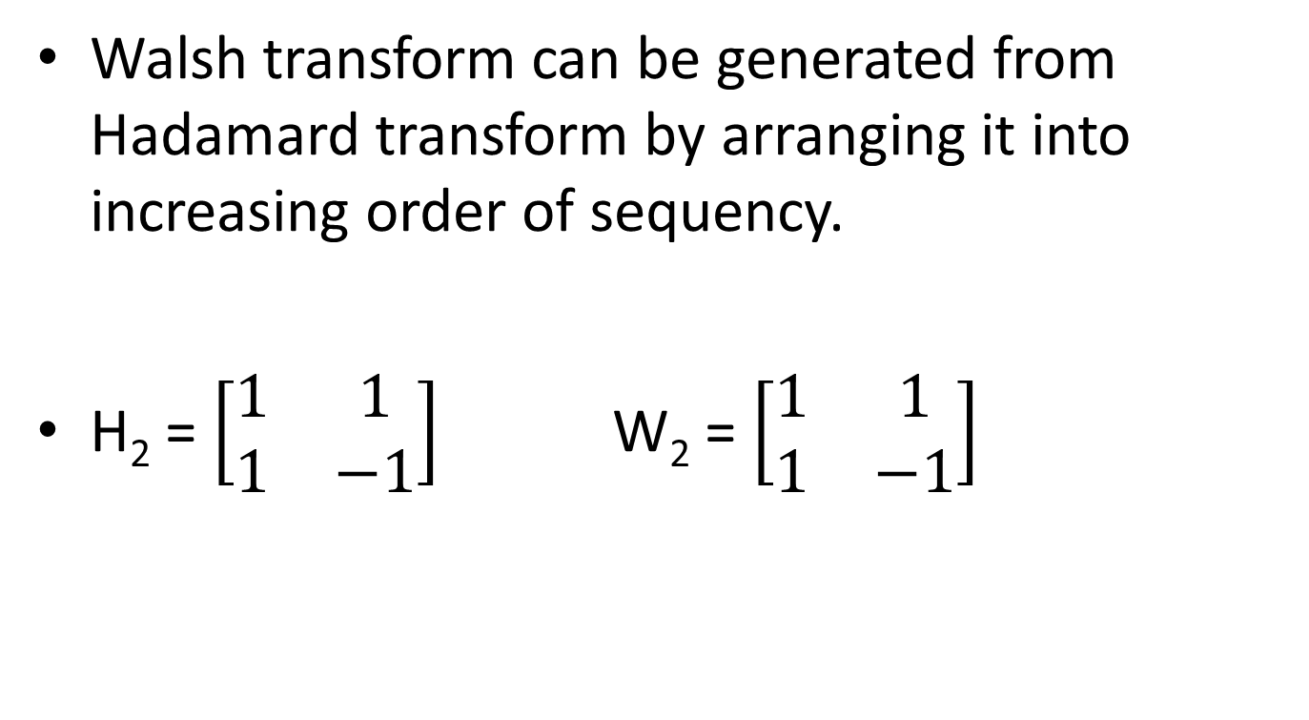
Walsh Transform
Walsh transform can be generated from Hadamard transform by arranging it into increasing order of sequency.
H₂ = $\left[\begin{matrix}1 & 1 \\ 1 & −1\end{matrix}\right]$ W₂ = $\left[\begin{matrix}1 & 1 \\ 1 & −1\end{matrix}\right]$

Slide 47


Sequency
Sequency
$W_{4}$ = $\left[\begin{matrix}1 & 1 & 1 & 1 \\ 1 & 1 & −1 & −1 \\ 1 & −1 & −1 & 1 \\ 1 & −1 & 1 & −1\end{matrix}\right]\begin{matrix}0 \\ 1 \\ 2 \\ 3\end{matrix}$
$H_{4}$ = $\left[\begin{matrix}1 & 1 & 1 & 1 \\ 1 & −1 & 1 & −1 \\ 1 & 1 & −1 & −1 \\ 1 & −1 & −1 & 1\end{matrix}\right]\begin{matrix}0 \\ 3 \\ 1 \\ 2\end{matrix}$

Slide 48
Walsh Transform
Sequency
H₈ ₌

Slide 49
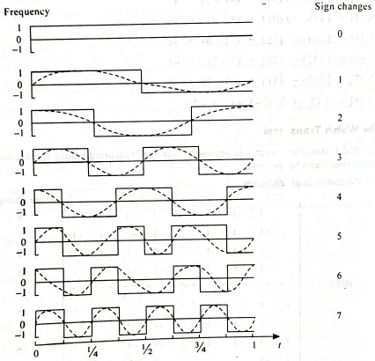

Slide 50
Problem 1
Compute the discrete Walsh Transform of the data sequence {1 2 0 3}’

Slide 51
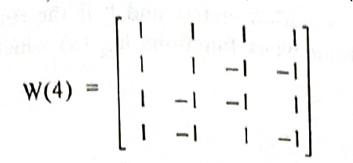
Solution 1
N = 4, hence we use W₄

Slide 52
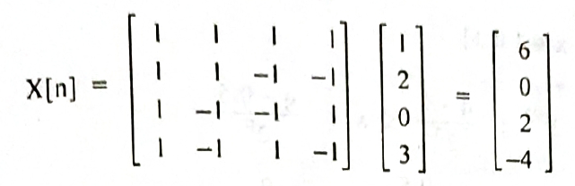

Slide 53

Problem 2
Apply the Walsh transform to the given image
$$\left[\begin{matrix}2 & 1 & 2 & 1 \\ 1 & 2 & 3 & 2 \\ 2 & 3 & 4 & 3 \\ 1 & 2 & 3 & 2\end{matrix}\right]$$

Slide 54
Solution 2

Slide 55
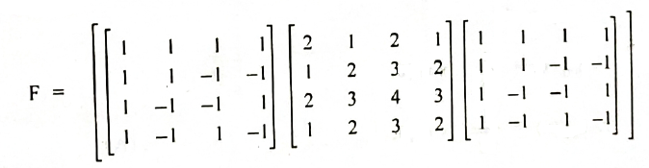
Solution 2

Slide 56
Solution 2

